Slide 1
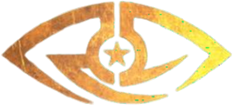
Senior Design Project
Horus
Furkan Demir 21802818
Can Kılıç 21703333
Muzaffer Köksal 21803125
Asya Doğa Özer 21803479
Ufuk Palpas 21702958

Slide 2
Table of content
Introduction
What is Horus
Where is Horus
Why Horus
Architecture of Horus
User Interface
Dataset
Training/Testing
Hyper Parameters
Emotion Detection
Crowd Control
Analysis
Deception Detection
Mobile Application

Slide 3
What is Horus
Horus is a desktop and mobile app that aims to recognize single or multiple human emotions.

Slide 4
Where is Horus
Stand-up, movie, art activity show, or a classroom
Possible Usage Areas
Video conference calls such as Zoom.
Prison's common areas

Slide 5
Why Horus
Provide feedback
Possible Reasons in these Areas
Detects multiple nervous, angry prisoners, it will alert the guards
Provide feedback

Slide 6
Architecture of Horus

Slide 7
User Interface
We used PyQt to create the basic scheme and the qt designer to create the pyqt5 code of the design we did.

Slide 8
Dataset
FER2013
Old dataset with 7 categories
( 0=Angry, 1=Disgust, 2=Fear, 3=Happy, 4=Sad, 5=Surprise, 6=Neutral)
48x48 grayscale images.
Initially used but later discarded.
28709 images

Slide 9
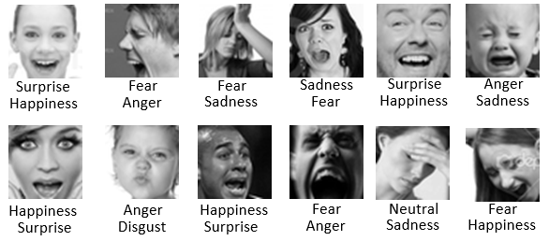
Dataset
FER+
Newer dataset with 8 categories
(neutral, happiness, surprise, sadness, anger, disgust, fear, and contempt)
48x48 grayscale images.
Figure 1: Differences between Fer2013 and FER+ [1]

Slide 10
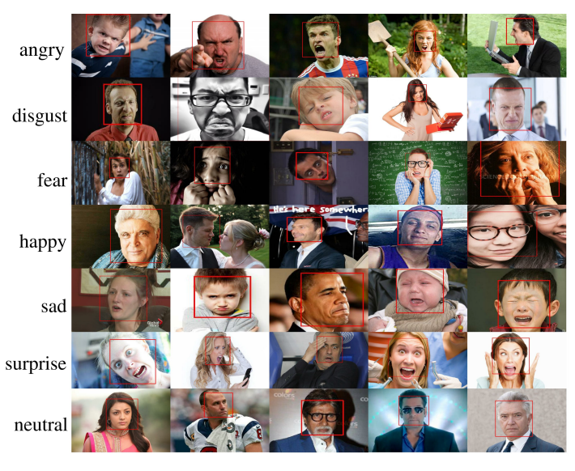
Dataset
ExpW(EXPRESSION IN THE WILD)
Has 7 categories
“angry”, “disgust”, “fear”, “happy”, “sad”, “surprise”, or “neutral”
91,793 faces manually labeled with expressions.
Figure 2: Images from Expw Dataset [2]

Slide 11
Hyper Parameters
Batch-size: 64
Epoch number = 300
Learning rate: 0.0005

Slide 12
Pre-Processing
rescale=1./255
rotation_range = 10
horizontal_flip = True
width_shift_range=0.1
height_shift_range=0.1
fill_mode = 'nearest')

Slide 13
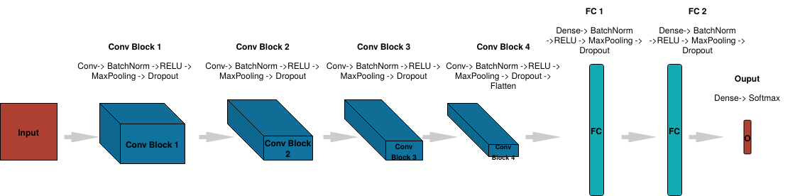
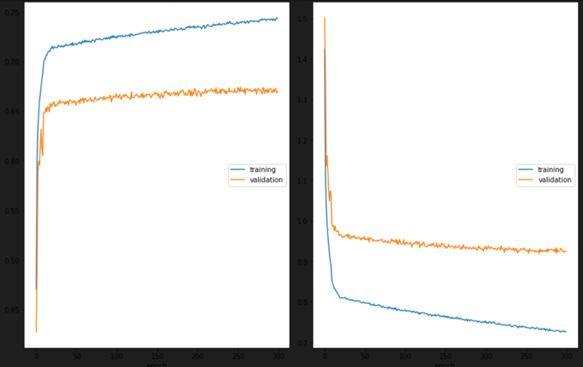
Training/Testing
Figure 3: Chart of our CNN model [3]
A CNN model with 4 convolutional layers and 3 dense layers.
Total: 4,478,727 parameters.
Train, validation and test sets are taken as in the datasets.
Trained for 300 epochs around 24 hours.
Test results show that 82% accuracy over 7 emotions
Figure 4: Our train results

Slide 14
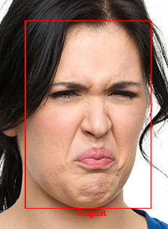
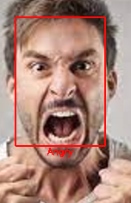
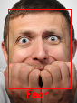
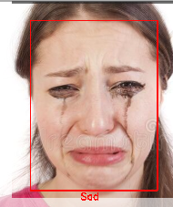
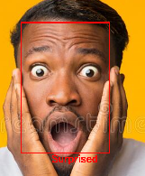
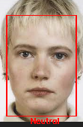
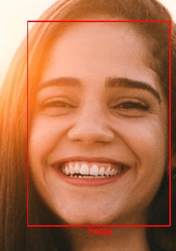
Emotion Detection (Single Mode)
First, we use a DNN model weights which is trained using CAFFE framework to detect faces. Best choice for real time analysis.
Then use those faces with the weights of our model to determine among 7 emotions.
Show momentary emotions on video and the bar chart in real time.
4 Different Charts are created at the end.
Option to run from saved video.
Figure 5: Disgust, Angry, Fear outputs
Figure 6: Sad, Surprised, Neutral, Happy outputs of our program

Slide 15
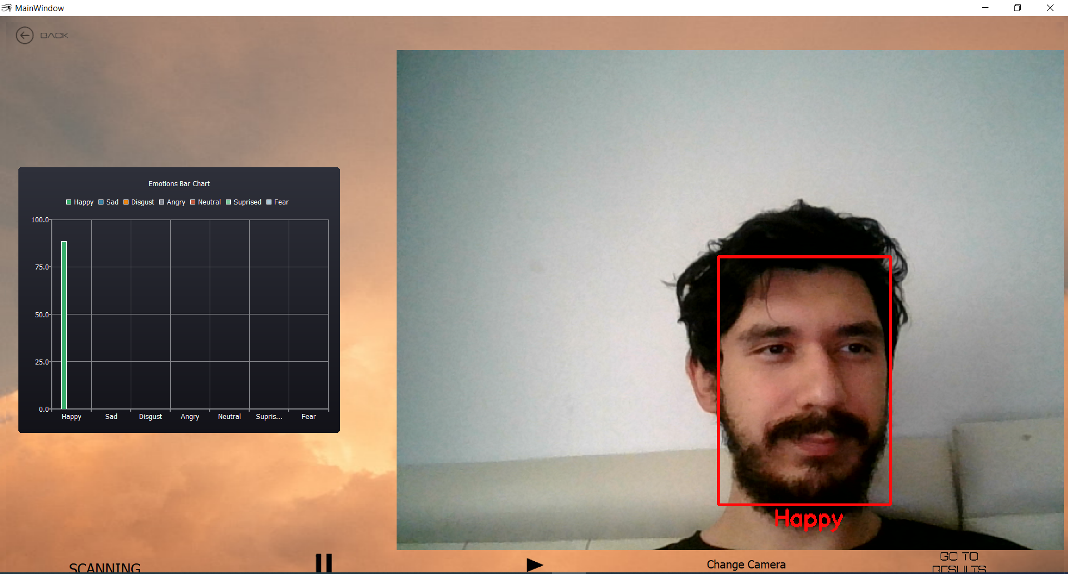
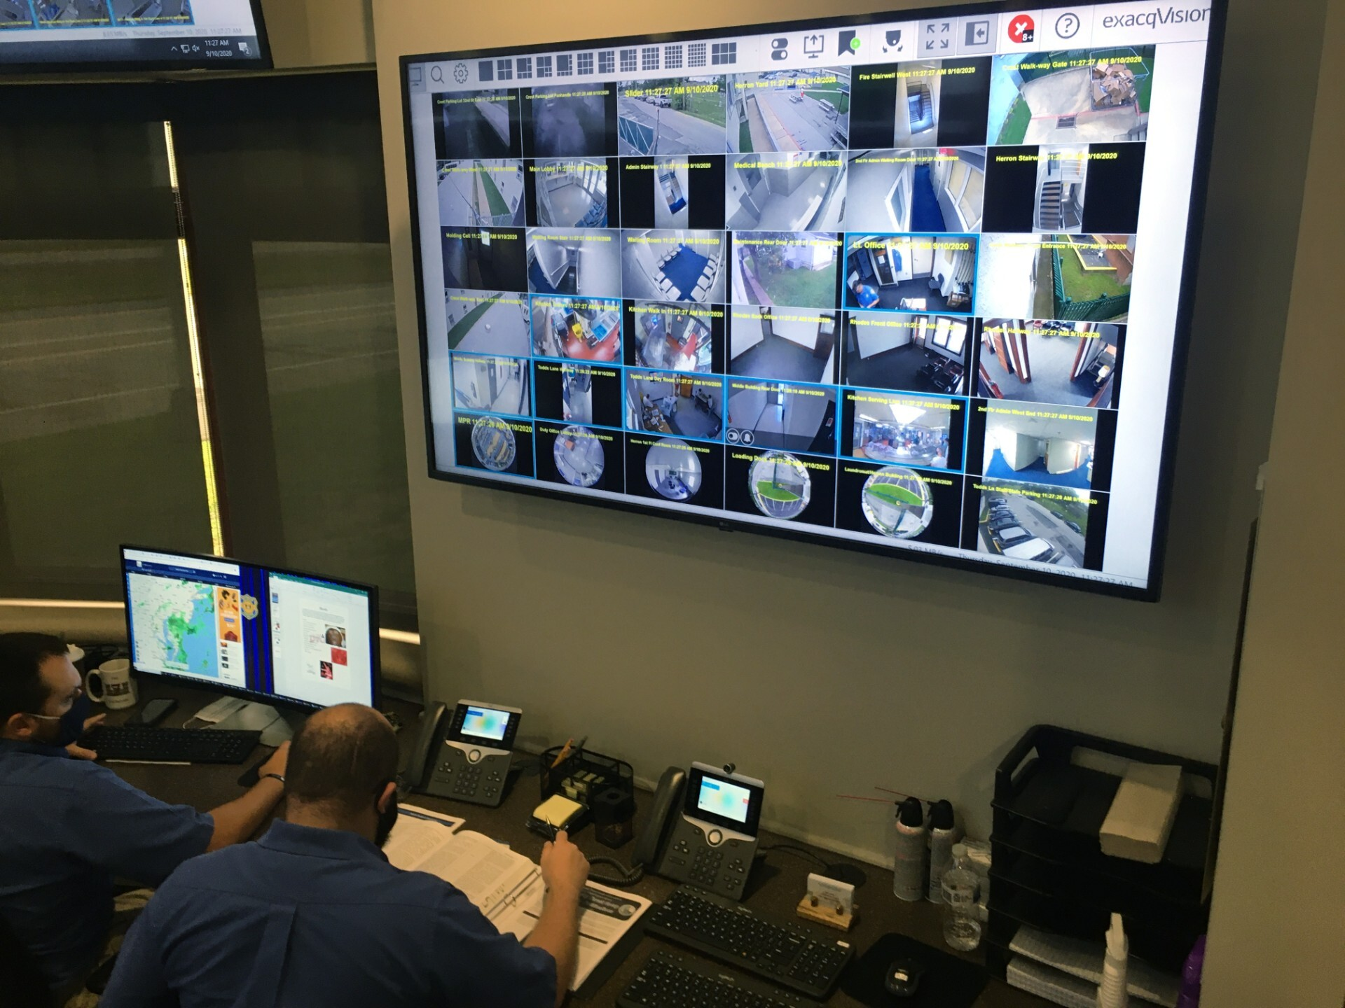
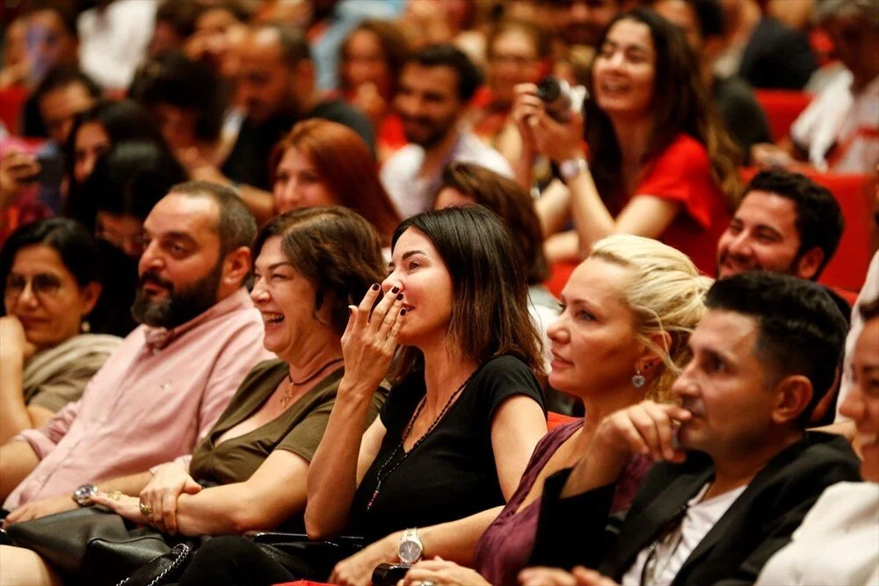
Crowd Control
The difference in the UI is the change camera option which allows user to view another camera's recording.
Crowd Control mod can be used for variety of purposes. For example:
Figure 7: A screen from crowd control mode
Figure 8: Audience Figure
Figure 9: Multi Screen Example

Slide 16
Crowd Control
To enable multiple cameras at the same time without losing performance, we use multi-threaded software for this part.
There is a manager thread who manages all the other threads, and there are working threads each of them responsible for a single camera which operates like single user mode.
At the end of the operation, manager thread collects all the data from the working threads for the analysis part.

Slide 17
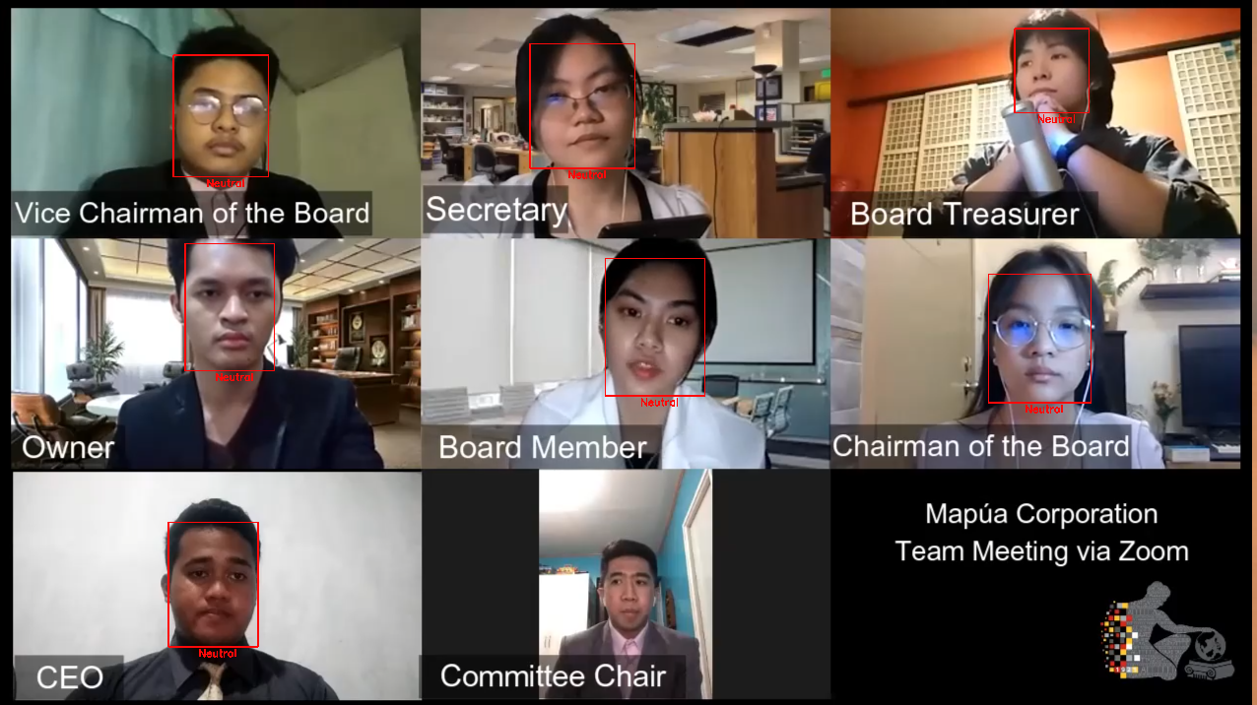
Screen Capture
Screen Capture mod is another feature which we developed for video conferences or similar areas of use.
Horus takes the screen as the input in frames to mimic camera recording behaviour. Then runs the same model on the single mod to the screen and recognize emotions.
This mod can be used in school, business or any social media gathering to analyze the participants emotions throughout the event.
Then the analysis of the multiple participants displayed on the results screen.
Figure 10: A screen from screen capture mode

Slide 18
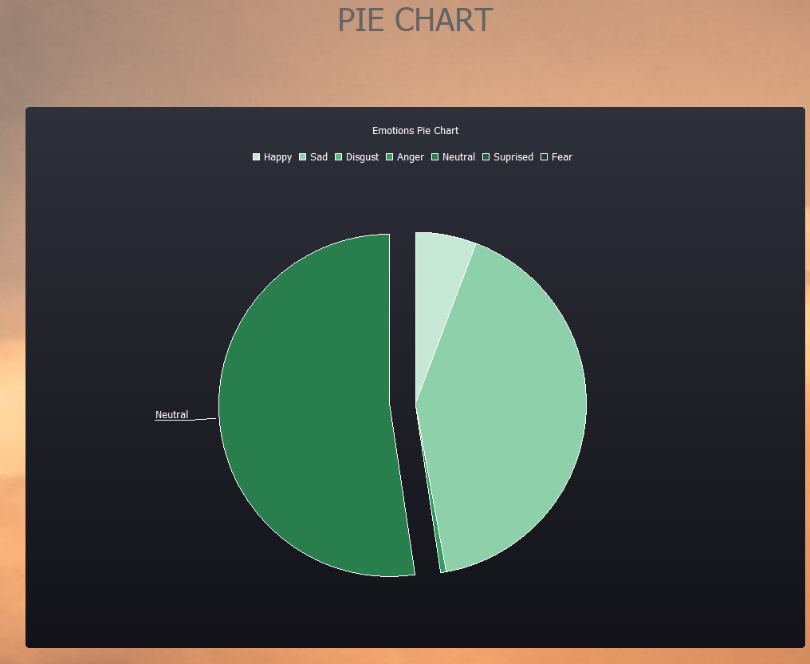
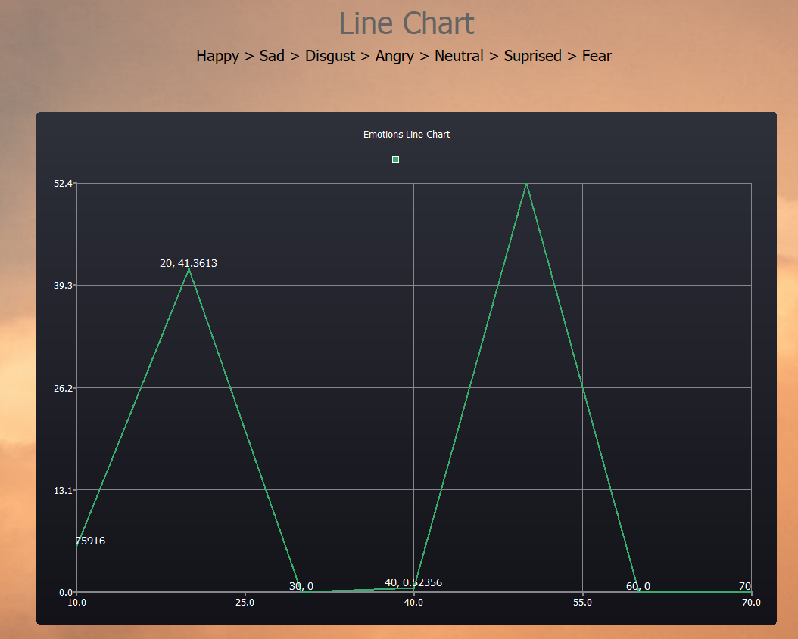
Analysis
We have different types of analysis visualizations:
Figure 11: An example pie chart
Figure 12: An example line chart

Slide 19
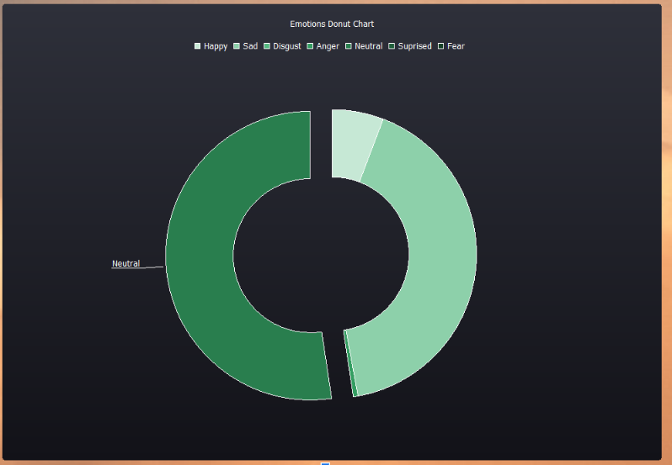
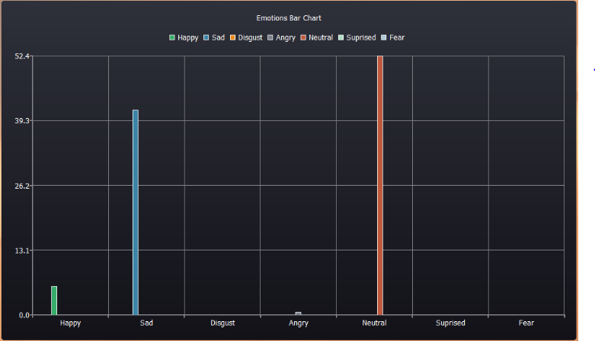
Analysis
Figure 14: An example donut chart
Figure 13: An example bar chart

Slide 20
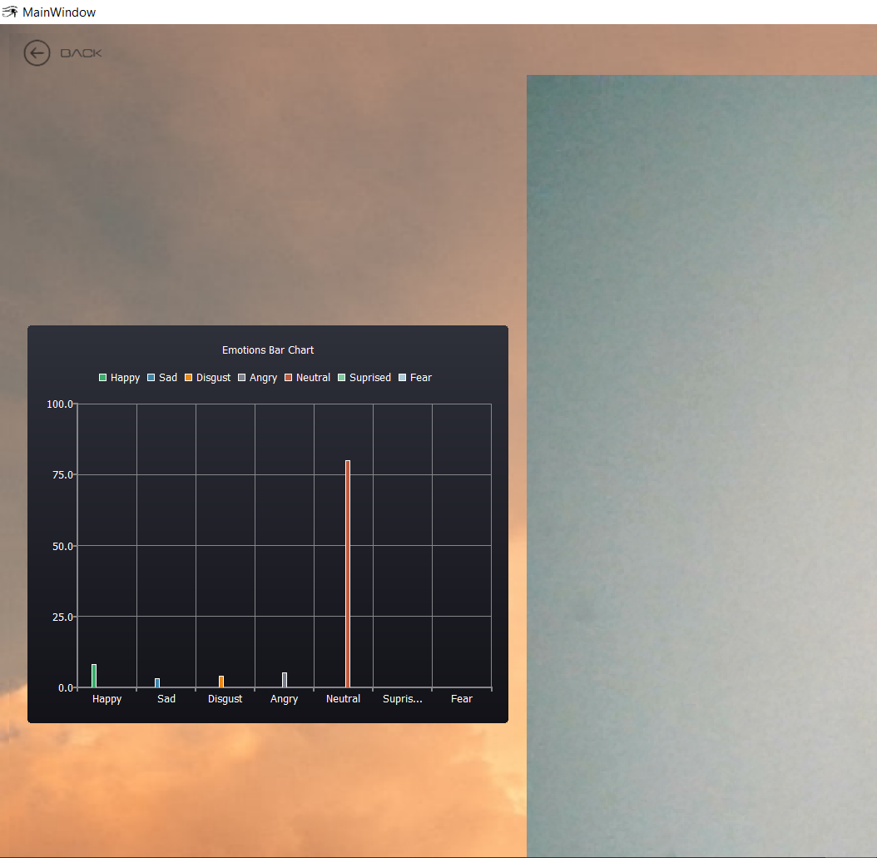
Analysis
For single and screen capture mods, the program collects data in real-time and displays it on the screen while the camera is on:
To not overwhelm the user with always changing histogram, we update the bars every 8 frames.
In single user mode, bars display the percentage of the prediction of that emotion on the user's face.
In screen capture and crowd control mod, since we aim to detect multiple faces in these mods, bars display the percentage of the found emotions against to all the emotions detected.
After the detection phase is over, all the data that represented in the histogram during the detection is gathered and put into the final analysis shown before.
Figure 15: Realtime bar chart

Slide 21
Deception Detection
Models we experimented:
SVM
Logistic regression
DTC
SGD
NN
Best one : Logistic Regression
Dataset : Real-life deception detection dataset (2016)
121 videos

Slide 22
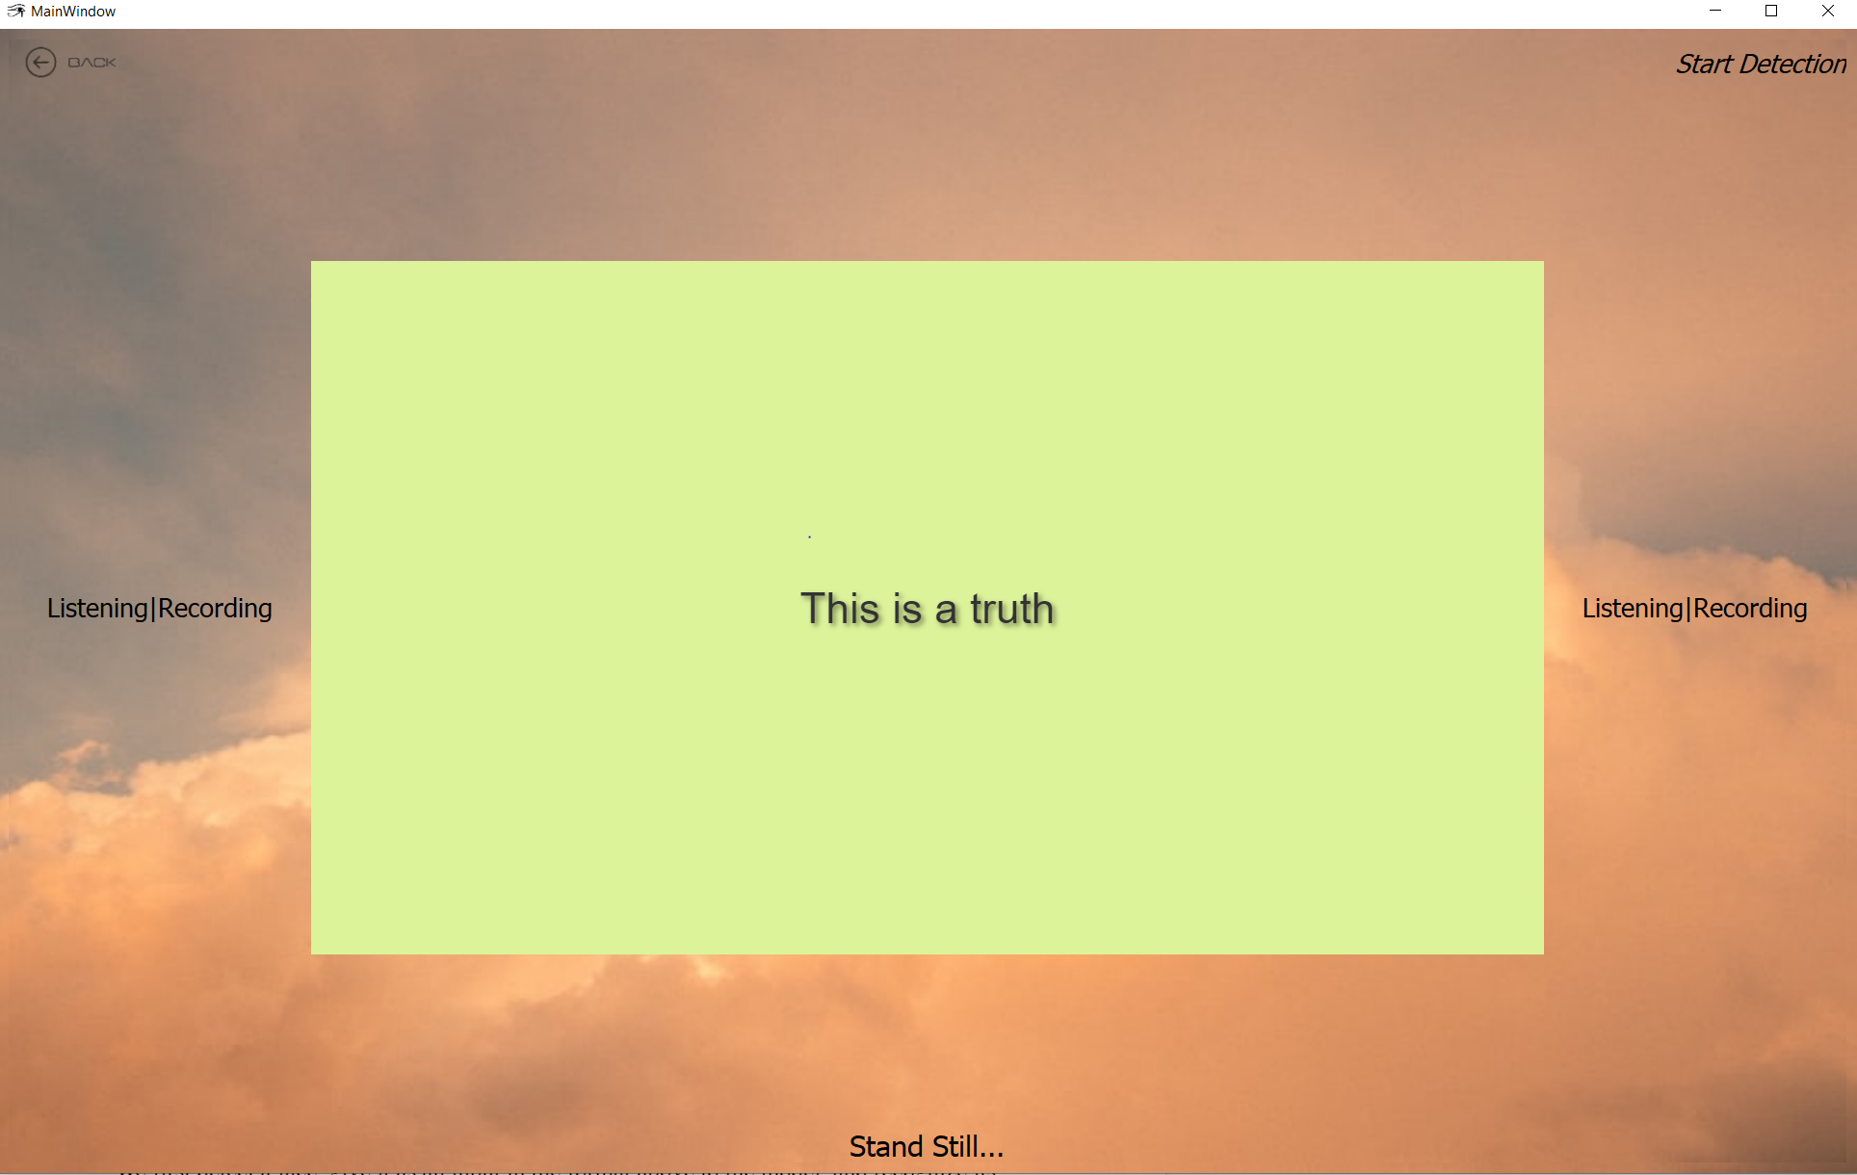
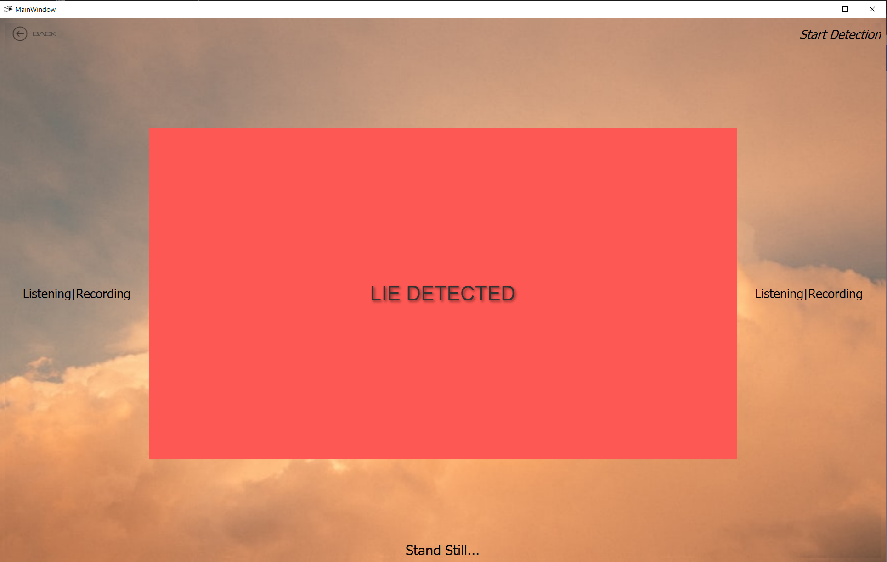
Deception Detection
If prob. difference > 0.2 ➞
Micro Emotion
If prob. difference < 0.2 ➞
Logistic Reg. Model
Micro Emotion: emotion seen less than 10 frames
Micro emotions > 8 ➞ LIE
Figure 16: Truth detected screen
Figure 17: Lie detected screen

Slide 23
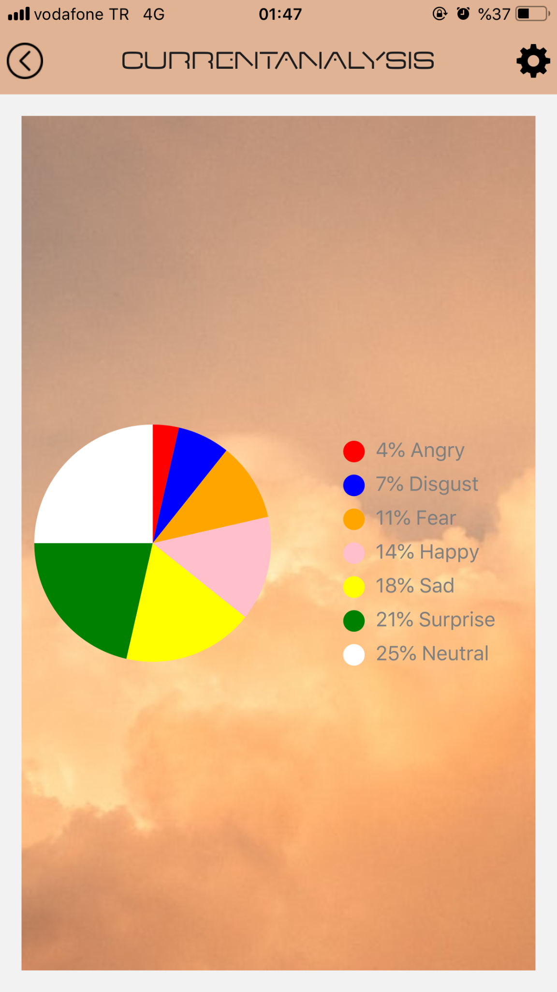
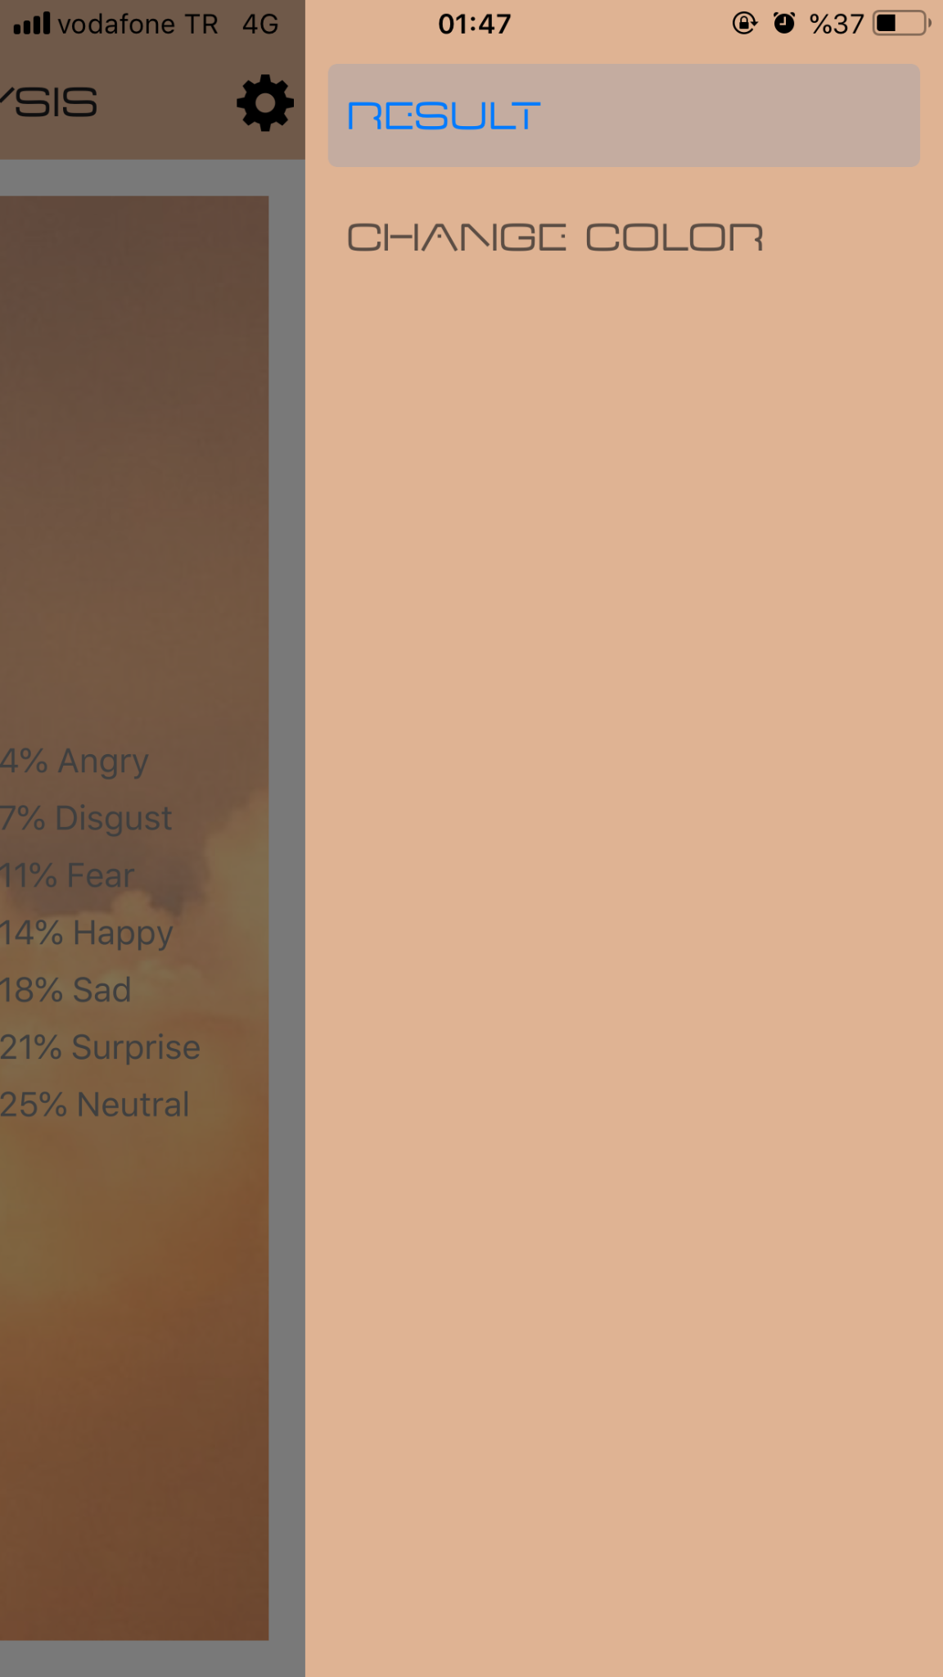
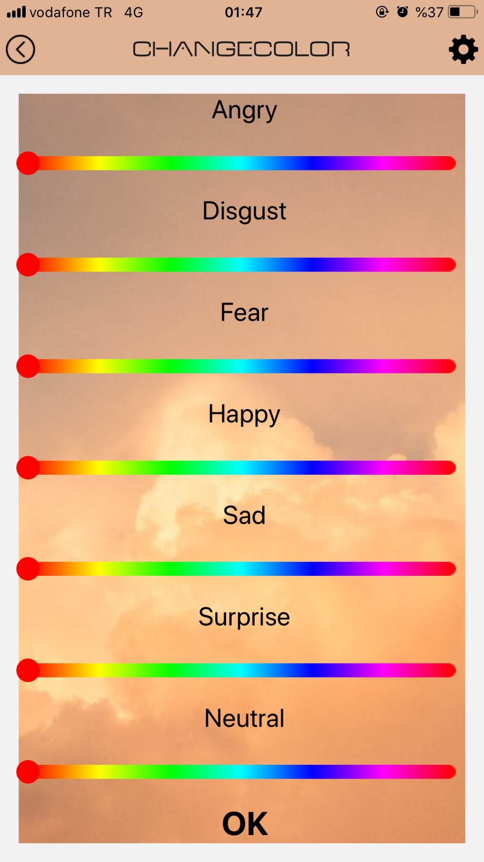
Mobile Application
Figure 18, 19, 20: The Mobile Application Screens

Slide 24
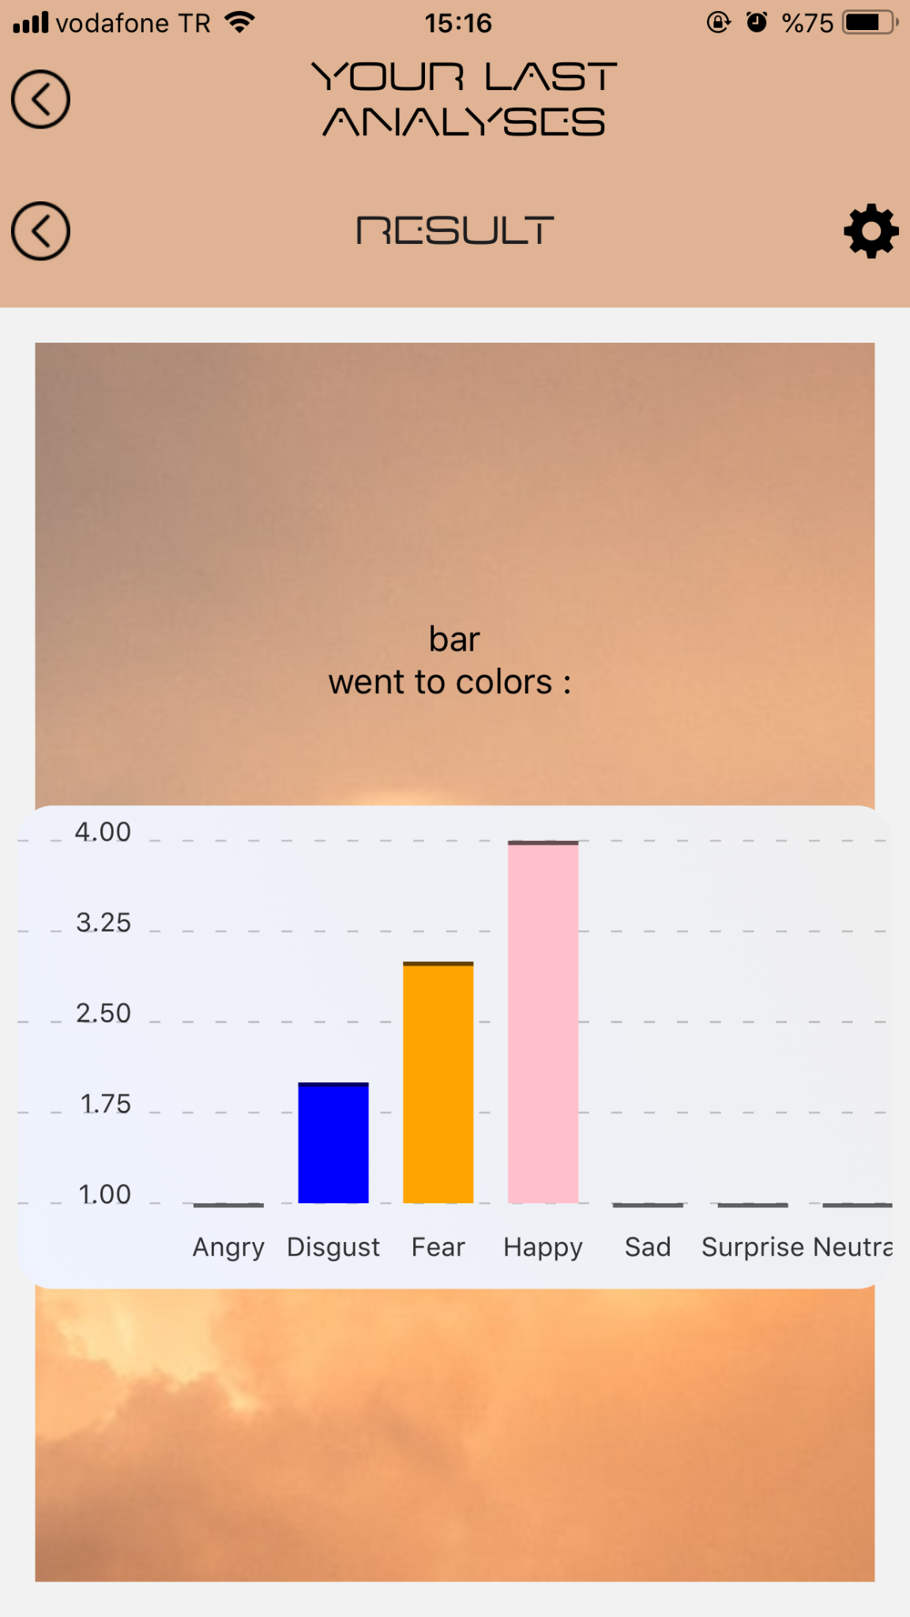
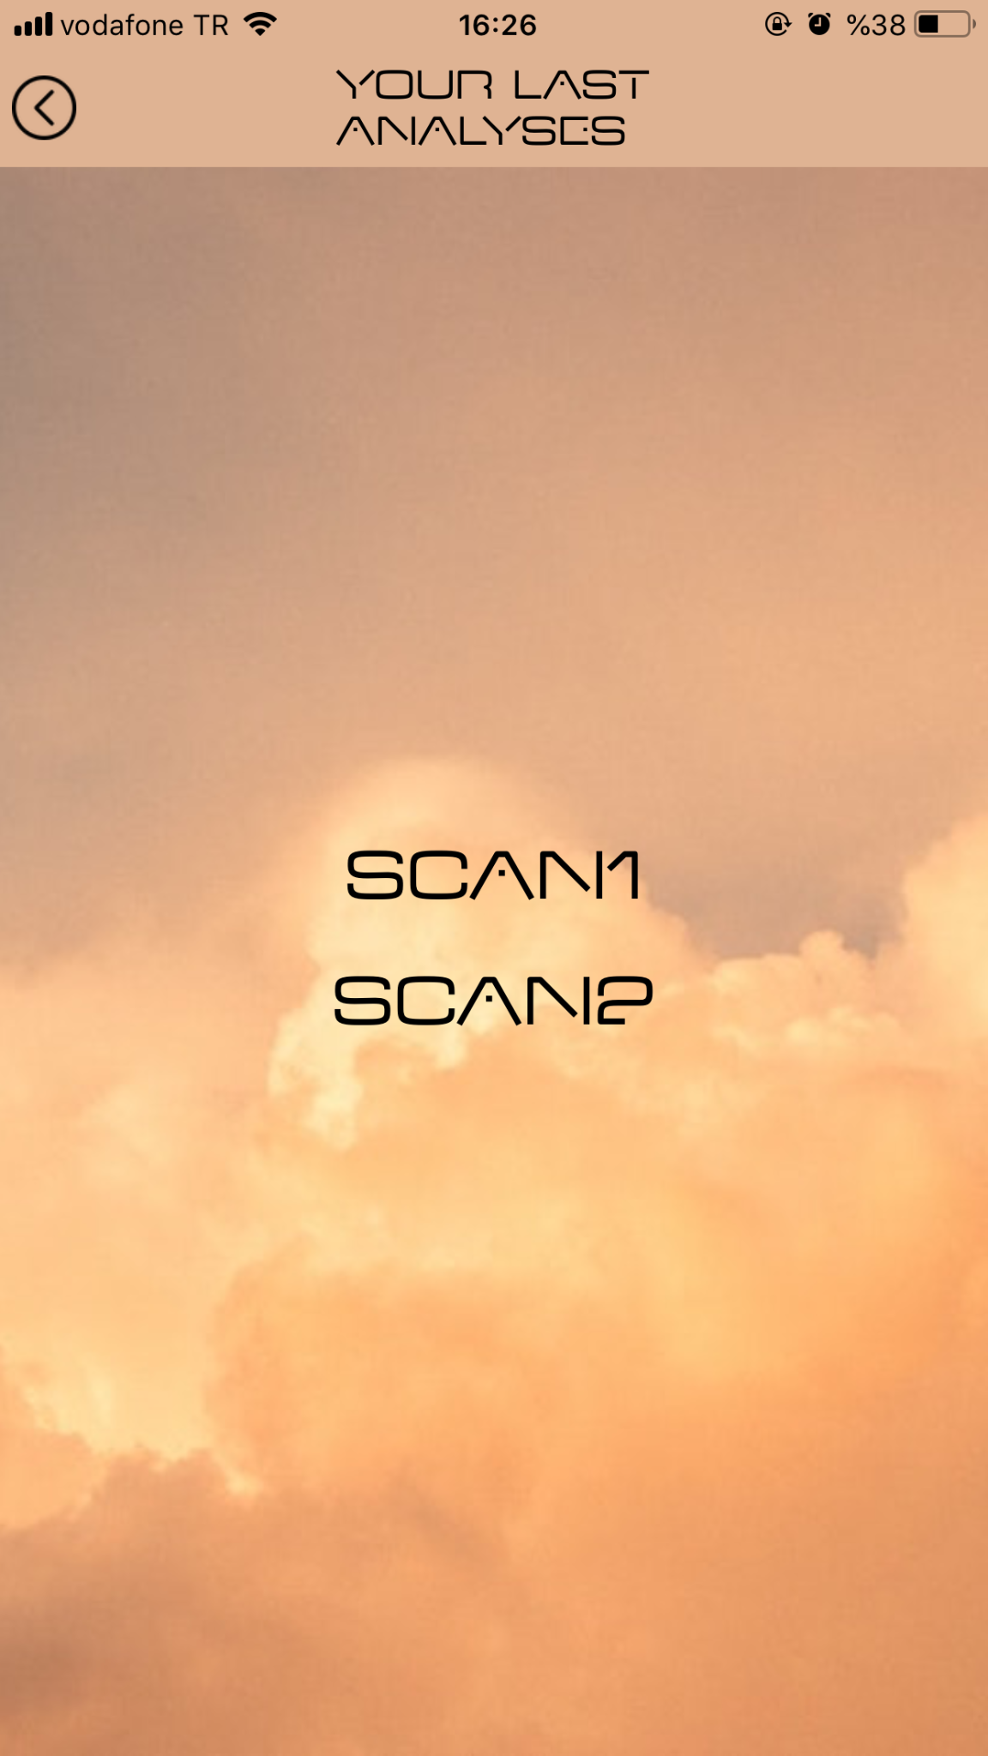
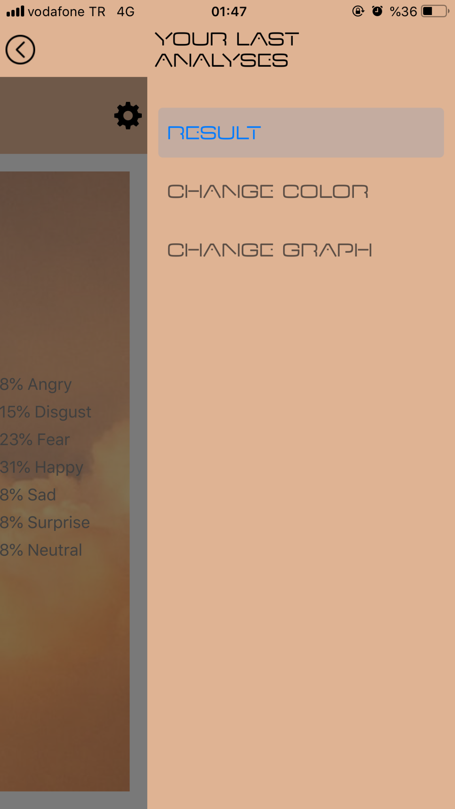
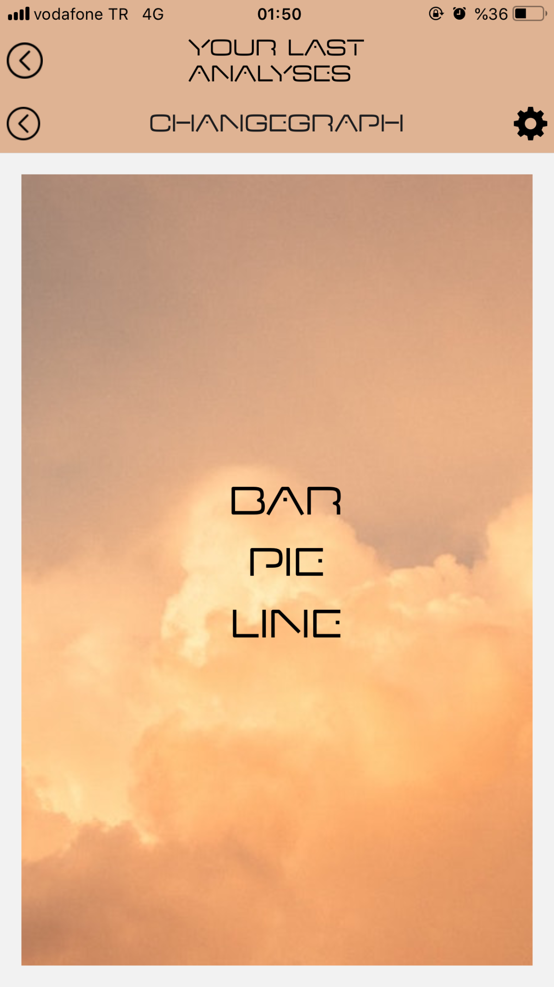
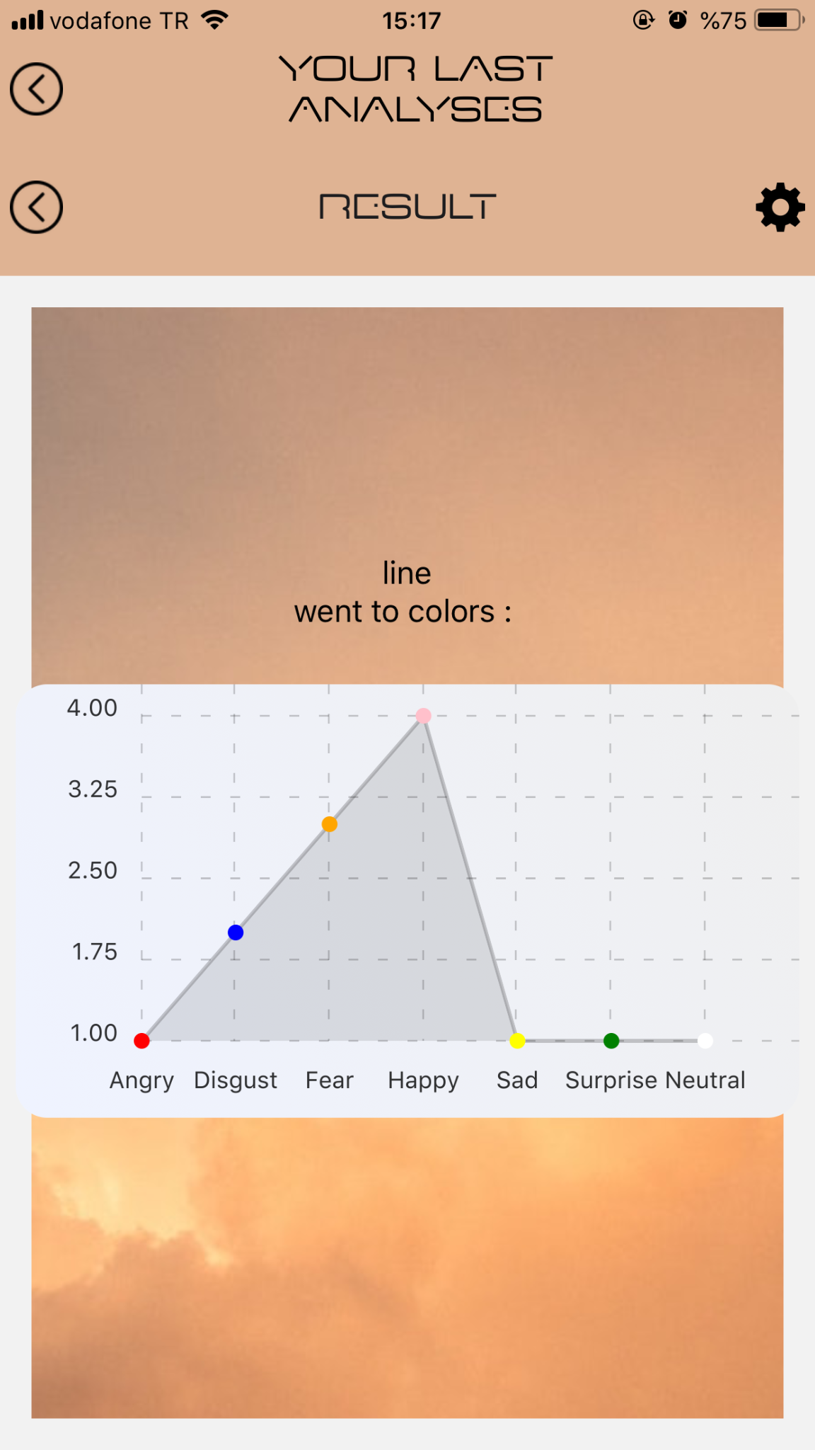
Mobile Application
Figure 21, 22, 23: The Mobile Application Screens
Figure 24, 25, 26: Graphic Styles

Slide 25
References
[1] Microsoft, “Microsoft/FERPlus: This is the FER+ new label annotations for the emotion FER dataset.,” GitHub. [Online]. Available: https://github.com/microsoft/FERPlus. [Accessed: 10-May-2022].
[2] Learning social relation traits from face images. [Online]. Available: http://mmlab.ie.cuhk.edu.hk/projects/socialrelation/index.html. [Accessed: 10-May-2022].
[3] Ruslan Magana Vsevolodovna, “Facial expression recognition with neural networks,” Ruslan Magana Vsevolodovna, 06-Feb-2021. [Online]. Available: https://ruslanmv.com/blog/Facial-Expression-Recognition-with-Neural-Networks. [Accessed: 10-May-2022].

Slide 26
Thanks For Listening

